Slide 1
WebWiz: Your AI-Powered Browser Agent
Calvin Li

Slide 2
What is WebWiz?
WebWiz is an AI-powered browser agent designed to automate web-based tasks
It mimics human behavior to interact with websites intelligently and efficiently
Todo: integrated as a plugin for ElizaOS to empower your workflows

Slide 3
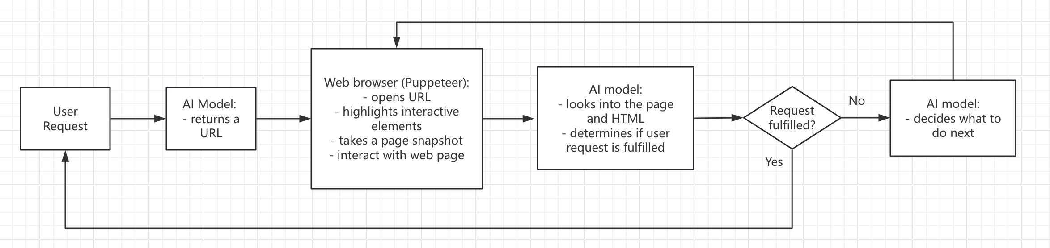
How Does It Work?

Slide 4
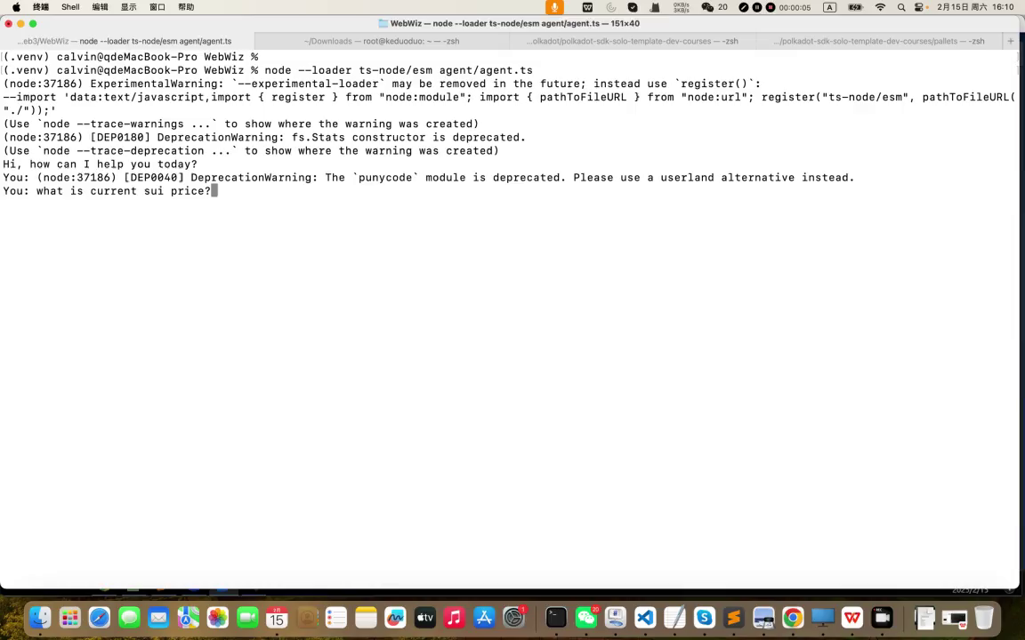
Demo Sui Price
What is current sui price?

Slide 5
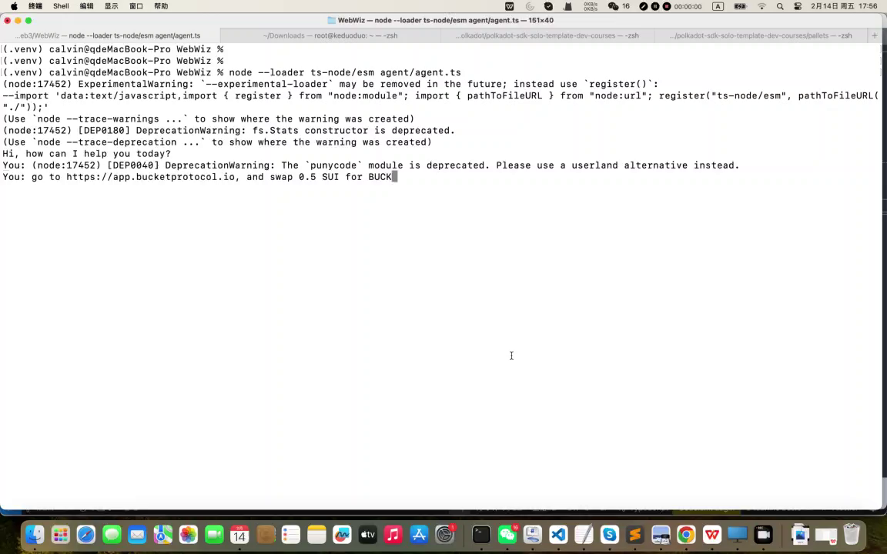
Demo Sui Swap
go to bucket web site, and swap 0.5 SUI for BUCK

Slide 6
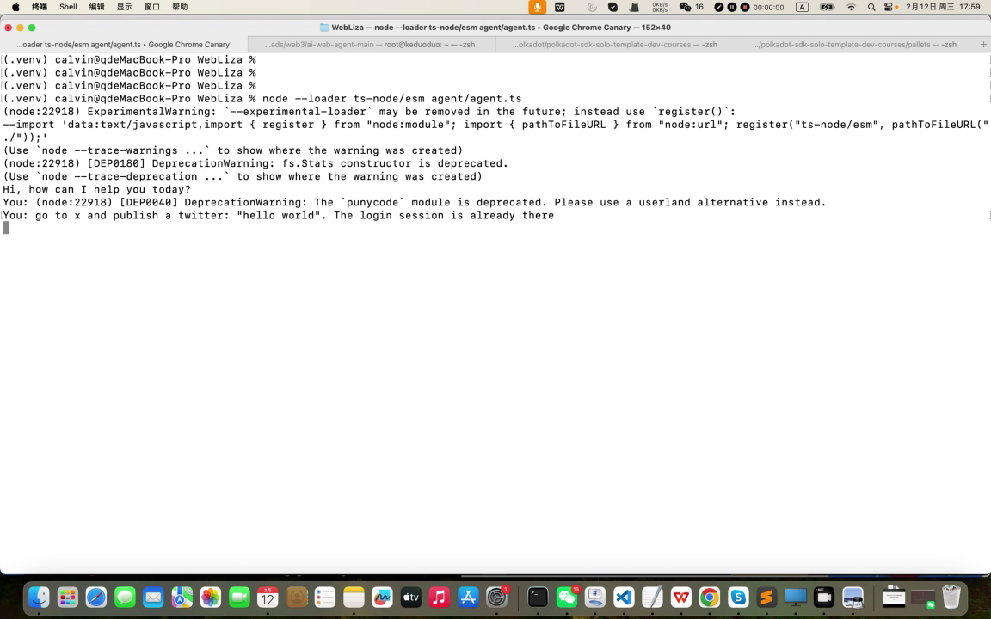
Demo Twittering
go to x and publish a twitter: “hello world”

Slide 7
Thank you!

